Slide 1
『产业区块链』新时代实体经济转型升级的助推器
Industrial Blockchain
Booster for the Upgrading of the Real Economy
于佳宁 博士
Dr.Yu Jianing
火币大学校长 President of Huobi University
中国通信工业协会区块链专委会副主任委员 Deputy Director of the CCIAPCB
中国国际经济技术合作促进会区块链技术与应用工委 副秘书长
Deputy Secretary General of the Blockchain Technology and Application Working Committee of CAPC
《2018中国区块链产业白皮书》 编委会主任 "2018 China Blockchain Industry White Paper" Editorial Board Director

Slide 2
互联网的迭代与升级
Internet iteration and upgrade
01
02
03
Web 1.0
文字消息 Text message
聊天室 Chat Room
Web 2.0
多媒体 Multimedia
社交网络 Social network
Web 3.0
移动互联网
Mobile Internet
04
05
Web 4.0
物联网 IoT
工业互联网 Industrial internet
Web 5.0
价值互联网
Internet of Value
价值类信息的传播 Value class information dissemination
权益的数字化 Digitization of rights

Slide 3
链村的故事——区块链基本原理解析 A Store of BlackChain Village Analysis of the Basic Principle of Blockchain

Slide 4



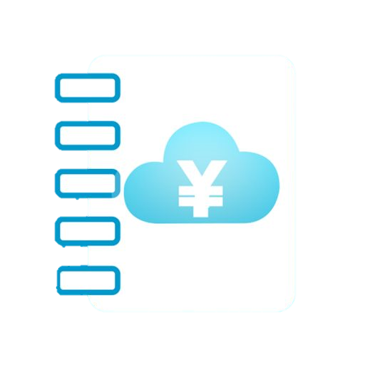
借款100元
Borrowing 100
村民老李
Villager Li
村民老孙
Villager Sun
记录
Record
记录
Record
村长
village head
中心化记账
Centralized accounting

Slide 5
村长出远门，无法记账
The village chief is far away and cannot be accounted for.
村长家中遭窃，账本丢失
The village chief was stolen from home and the account book was lost.
村里发生灾害，
唯一的账本毁损
Disasters in the village,The only account book is damaged
村长年迈，记错账目
The village chief is old and remembers the wrong account
村长疏于防范，
账本被他人篡改
The village head is negligent in preventing,The book was tampered with by others
村长私自篡改账本
The village chief privately falsified the books
村长记账
难以防范的高风险
Village chief account bookHigh risk that is difficult to guard against

Slide 6




我老李在今年9月1日中午12点整借给老孙一百块钱!请大家记在账本里。
Li borrowed a hundred dollars from the old grandson at 12 noon on September 1 this year! Please remember it in the books.
听到广播的村民---分辨广播中的声音是否来自李某；
---查看历史账本中记载的老李所有余额
---验证无误后将该笔交易记录在自己的账本上
The villagers who heard the broadcast
---recognize whether the voice in the broadcast came from Li;
---View all the balances of Lao Li recorded in the historical books
--- After verifying the record, record the transaction on your own ledger
分布式记账
Decentralized accounting

Slide 7

分布式记账
Distributed accounting
各村民手中账本信息总是不一致，难以查明不一致的原因
The account information of each villager is always inconsistent, and it is difficult to identify the cause of inconsistency

Slide 8
此处应该还有一页PPT，是三个村民讨论变革记账方式地那一张，问子洵

Slide 9








验证广播中声音
来自老王本人
Verify the sound in the broadcast from Wang himself
村民将交易记录在自己的账页上
The villagers recorded the transaction on their own account page.
听到广播的村民
Villagers who heard the broadcast
村民老王
广播交易
Wang Broadcast transaction
账页
查看历史账本中
老王所有余额
View all the balances of Wang in the historical books
小赵用特定公式计算密码，写在账页上，随后把账页复印并分发给其他村民
Xiao Zhao uses a specific formula to calculate the password, write it on the account page, then copy and distribute the account page to other villagers.
晚上六点村民广场集合摇骰子
At 6 o'clock in the evening, the village square gathers shaking the dice
账页
账页
账页
村民小赵第一个摇到六个6, 获得记账权
The villager Xiao Zhao first shaken to six 6 and got the right to write.
验证小赵账页中的密码是否正确
Verify that the password in Xiao Zhao’s account page is correct.
其他村民查看
小赵的账页
Other villagers check Xiao Zhao’s account page
验证无误后，村民将小赵的账页加入自己的账本，完成当天记账
After the verification is correct, the villagers will add Xiao Zhao’s account page to his own book, and complete the day’s bookkeeping.
验证该笔交易的真实性
Verify the authenticity of the transaction
小赵获得红包

Slide 10
账页中包含哪些信息？如何验证记账的真实性？
What information is included in the account page?
How to verify the authenticity of accounting?
区块头
每一账页的密码与上一账页的密码相关
The password for each account page is related to the password for the previous account page.
若有村民篡改账页信息，其他村民会发现其账页中的密码和其余所有账页中密码不同，拒绝承认其账页有效性
If a villager tampers with the account information, other villagers will find that the password on their account page is different from the passwords on all other accounts, and refuses to acknowledge the validity of their account pages.
版本号
时间戳
上一账页密码
本页密码
交易数量
交易列表
其他村民通过查看密码验证账页内容真实性
Other villagers verify the authenticity of the contents of the account page by checking the password.
交易1：XXXXXX
交易2：XXXXXX
交易3：XXXXXX
…
交易n：XXXXXX

Slide 11
升级版分布式记账（区块链）
BlockChain
先对账，后入账，账目信息实时入账，对账后即可保证账本信息一致
Reconcile first, then account, Account information is recorded in real time, After the reconciliation, the account information can be guaranteed

Slide 12
认识区块链
Knowing the Blockchain
多中心化/点对点
Peer to Peer
“去信任化”
Detrusting
社区治理
特点
features
不可篡改
Not tampering
分布式存储
Distributed storage
改则穿帮
改则作废
先验证后记账
reconciling first, then keep accounts
开放透明
Open and transparent
通证
Token
ICO
智能合约
Smart contract

Slide 13
认识区块链
Knowing the Blockchain
区块链Blockchain
共识机制
Consensus mechanism
账本
Ledger
公链/联盟链/私链
Publick chain/Private chain/Alliance chain
区块 Block
账页
POW（挖矿）/
POS/DPOS
多种技术融合形成的新技术模式
New technology model formed by the integration of multiple technologies

Slide 14
认识区块链
Knowing the Blockchain
 | 私有链 | 联盟链 | 公有链
参与者 | 个体或公司内部 | 特定人群，入盟协议 | 任何人自由进出
信任机制 | 自行背书 | 集体背书 | POW/POS/DPOS
记账人 | 自定 | 参与者协商决定 | 所有参与者
激励机制 | 不需要 | 可选 | 需要
中心化程度 | 中心化 | 多中心化 | 去中心化
突出优势 | 透明和可追溯 | 效率和成本优化 | 信用的自建立
典型代表 | Overstock | R3的银行联盟 | 比特币和以太坊
承载能力 | 网络传输和硬盘写入速度决定 | 1000-1万笔/秒 | 3-20笔/秒
BaaS（ Blockchain as a Service）

Slide 15
认识区块链
Knowing the Blockchain
 | Private chain | Alliance chain | Public chain
Participant | Individual or company internal | Specific population, accession agreement | Anyone free to enter and exit
Trust mechanism | Endorsement | Collective endorsement | POW/POS/DPOS
Bookkeeper | Custom | Participant negotiated | all
Incentives | NO | option | need
Degree of centralization | Centralization | Multi-centered | Decentralization
Outstanding advantages | Transparent and traceable | Efficiency and cost optimization | Self-establishment of credit
Typical representative | Overstock | R3 Bank Alliance | Bitcoin&Ethereum
capacity | Network transmission & I/O | 1000-10,000/s | 3-20/s
BaaS（ Blockchain as a Service）

Slide 16
区块链的迭代升级
Iterative Upgrade of Blockchain
01
02
03
BlockChain1.0
比特币
BTC
BlockChain2.0
智能合约
Smart Contract
BlockChain3.0
产业区块链
Industrial Blockchain
区块链≠比特币
BlockChain≠Bitcoin

Slide 17
狭义的区块链产业
Narrow blockchain industry
区块链产业已经成为创新高地
Blockchain industry has become an innovative highland
持续创新continue to innovate
设备制造Equipment manufacturing
110nm
55nm
28nm
16nm
7nm
A
B
KPU芯片
infrastructure基础设施
嘉楠耘智发布了全球第一款量产人工智能芯片KPU
卷积计算性能是目前主流CPU芯片的1000倍
Jia Nan Zhizhi released the world's first mass production artificial intelligence chip KPUConvolution calculation performance is 1000 times that of current mainstream CPU chips
技术服务Technical Services
C
D
Industrial service产业服务
Notes:
TPU，7纳米

Slide 18
2018年中国区块链产业生态：区块链+在24个产业场景实现应用落地
产业应用：金融领域应用
产业应用：实体领域应用
应用：政府和监管部门
供应链金融
贸易金融
商品溯源
版权保护与交易
数字身份
监管
解决中小微企业融资难问题，12-15万亿市场
解决银行之间信用证、保函、福费廷、保理、票据等信息同步问题
解决商品的生产、加工、运输、流通、零售等环节信息不透明
解决数字版权确权、版权内容价值流通环节多、效率低等问题
解决计算机系统世界中人员信息与社会身份关联的问题
穿透式监管与政策保障
区块链行业服务
征信
交易清算
财务管理
电子证据
物联网
电子政务
行业网站 & 媒体
解决资本市场、商业市场、个人消费市场评估机构信息共享
解决清算业务环节多，清算链条长，导致对账成本高、耗时长等
解决账目数量大、类别繁琐、企业间合作负责带来的经营成本高、效率低、监管难等
解决司法机构、仲裁机构、审计机构取证成本高、仲裁成本冗余、多方协作效率低
解决中心化设备采购、运维成本高，安全防护性差等问题
解决跨级别、跨部门的数据互联网通信安全问题，提升政务效率
充分竞争：数字资产火爆以来，大笔资本进入区块链媒体、社区方面进行布局
积分共享
保险
工业
能源
大数据交易
投资机构
银行/企业的会员积分系统不能通用、积分利用率低、消费困难
解决身份“唯一性困境”，为防范保险欺诈提供有力技术保障
解决多方协同生产、数字安全、资产数字化等制造业转型升级的问题
解决能源生产、能源交易、能源资产投融资和节能减排过程中数据孤岛、效率低等
解决数据需求方的合法用户，又保护用户隐私的问题
充分竞争：股权投资和Token投资机构交相辉映
证券
数字营销
医疗
公益
教育培训
解决中央银行、中央登记机构、资产托管人、证券经纪人之间流程繁复、信息不透明、效率低等问题
解决虚假流量和广告欺诈等现象导致的广告主和广告代理商信任缺失问题
解决患者敏感信息的隐私保护和多方机构对数据的安全共享问题。
解决信任缺失问题。
早期阶段：早期知识普及、布道阶段
区块链硬件
底层平台
解决方案
数字资产存储
安全服务
区块链基础设施与平台
巨头垄断：比特大陆、嘉楠耘智为全球前二大区块链硬件生产商
市场争夺：公有链、联盟链、BaaS等底层系统，无论大公司还是创业公司，都在布局底层平台
市场争夺：为特定的商业场景提供一整套解决方案的企业级服务
使用数字钱包保管加密数字资产，中国目前有15家公司从事冷钱包、热钱包业务
早期阶：针对区块链存在的安全问题，提供代码审计、技术顾问、技术支持等方面的服务。
来源：《2018年中国区块链产业白皮书》，于佳宁/主编，工业和信息化部信息中心，2018年5月

Slide 19
区块链应用广泛落地
Blockchain applications are widely used
Financial application
supply chain finance
Trade finance
Credit
Transaction clearing
Point sharing
Insurance
Securities
产业
应用
Government and regulatory authorities
Product traceability
Copyright protection and trading
Digital identity
Financial Management
Electronic evidence
Public welfare
IOT
Physical industry application
Big data transaction
digital marketing
E-government
industry
energy
Medical
基础设施与平台
行业服务
Investment agency
Blockchain hardware
Underlying platform
solution
Digital asset storage
Security service
Industry Website & Media
Education and training
Notes:
解决钱：金融
解 决场地：土地流转
解决工具：农机服务
解决原料：农资服务
解决方法：农技服务
解决产品销售：农产品流通
解决劳动力：
农资供应、农产品收储加工、，大力开展订单销售、大田托管、土地流转、配方施肥、农机作业、统防统治、农村合作金融
日用消费品经销、再生资源回收利用等服务、物流配送

Slide 20
微版权+区块链=？
Minor copyright + BlockChain = ?

Slide 21
微版权供给需求迅速扩张
Minor copyright supply demand is expanding rapidly
微版权供给多元化
Micro-copyright supply diversification
微博、朋友圈、头条号、短视频、手机直播……
草根网红IP明星化、IP形成模式逐步多元化
全民创意大时代 人人都是版权人
Weibo, Moments, TouTiaoHao, short video, live mobile phone...
Grassroots network red IP star, IP formation model gradually
diversified The era of universal creativity, everyone is a copyright owner
微版权需求扩大化
Micro-copyright demand expansion
用户付费显著提升，内容产业信息消费实现爆发增长
User fees have increased significantly, and information industry information consumption has exploded

Slide 22
“IP+产业”成为产业升级新风口
"IP+ industry" has become a new outlet for industrial upgrading
IP+制造业
以往：IP产业化
In the past: IP industrialization未来：产业IP化
The future: industrial IP
信息消费和实体消费协同“双升级”
Information consumption and physical consumption synergy "double upgrade"
内容产业将成为消费升级实体长尾需求的“流量入口”
内容产业引致的需求与智能制造“小批量、多品类、短生命周期”能力高度匹配
IP化产品将获得明显溢价
IP+零售业
实体文化消费将成为“新零售”的下一站

Slide 23
"IP+ industry" has become a new outlet for industrial upgrading
IP+ manufacturing
The content industry will become the "flow portal" for the long tail demand of consumption upgrade entities. The demand caused by the content industry is highly matched with the ability of intelligent manufacturing "small batch, multi-category, short life cycle"IP products will receive a significant premium
In the past: IP industrializationThe future: industrial IP
Information consumption and physical consumption synergy "double upgrade"
IP+ retail
Entity cultural consumption will become the next stop for “new retail”

Slide 24
区块链+微版权模式——以版权家为例——数据资产化
区块头
区块头
区块头
区块头
数据
数据
数据
数据
权属身份证明
存在性证明
授权交易证明
侵权证据固定
联盟链
BaaS
时间
签名
时间
签名
时间
签名
时间
签名
What
作品Hash
确定作品
Who
CA证书
确定身份
When
中国科学院授时中心
可信时间服务

Slide 25
Blockchain + micro-copyright model - taking copyright owners as an example - data assetization
Block Header
Block Header
Block Header
Block Header
Proof of ownership
Proof of existence
Authorized transaction certificate
Fixed evidence of infringement
data
data
data
data
Alliance
Chain
BaaS
timestamp
sign
timestamp
sign
timestamp
sign
timestamp
sign
Who
CA certificate
Sign(X)
When
Chinese Academy of Sciences Time CenterTrusted time service
What
Hash(X)

Slide 26
区块链+微版权模式——以版权家为例
Blockchain + micro-copyright model - taking copyright owners as an example
版权证明Proof of copyright
版权交易
Copyright transaction
创作即确权
Creation determines power
交易即授权
The transaction is granted power
发现即维权
Discovery of maintenance power
创作者
creator
数字作品
Digital work
存证
Deposit certificate
授权
Authorization
侵权监测
Infringement monitoring
维权服务
Rights protection service

Slide 27
商品溯源+区块链=？
Product traceability + blockchain =?

Slide 28
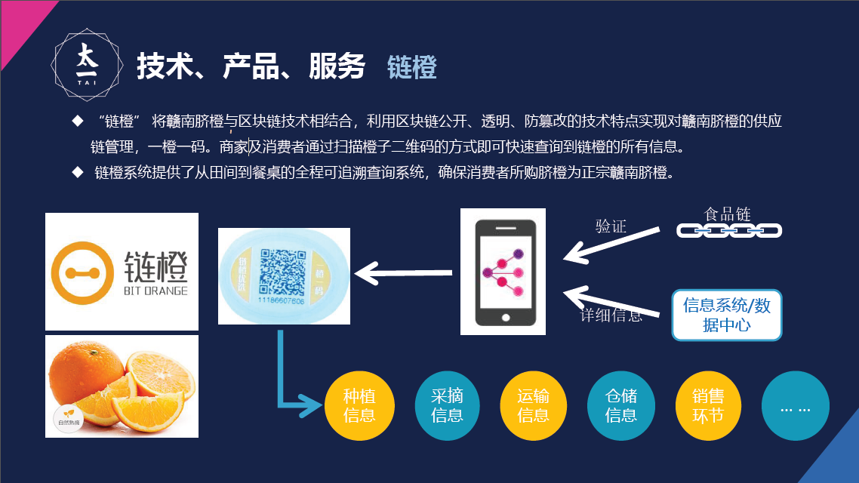
区块链+商品溯源——以溯源链为例
关键：实物如何可信映射到链上
物联网
人工智能
大数据

Slide 29
区块链+商品溯源——以溯源链为例
Blockchain + Commodity Traceability——Taking traceability chain as an example
食品评价
Food evaluation
订单查收
Order check
订单查询与跟踪
Order inquiry and tracking
订货
Order
销售
Sales
检验
Detection
加工
Processing
生产
produce

Slide 30
区块链+商品溯源
Blockchain + commodity traceability
政府
government
企业
enterprise
消费者
consumer
产业整体数字化
Industrial digitalization
穿透式监管
Penetrating supervision
事中监管
Regulatory supervision
精准处置
Precise disposal
区域品牌
Regional brand
原产地溢价
Origin premium
自证清白
Self-certification
积分体系
Point system
数字化转型
Digital transformation
产业链管控
Industry chain management
吃的放心
Eat at ease
用的放心
Reassuring
消费升级
Consumption upgrade

Slide 31
供应链金融+区块链=？
Supply Chain Finance + Blockchain =?

Slide 32
区块链+供应链金融——以腾讯区块链为例——“信任传递”引导资金脱虚向实
模式：以源自核⼼企业的应收账款为底层资产
通过区块链实现债权凭证的流转、保证不可篡改、不可重复融资，可被追溯
贸易合同
应收账款资产
债权凭证
转让拆分
债权凭证
转让拆分
债权凭证
转让拆分
1000万
500万
300万
100万
整车厂
轮胎厂
轮毂厂
铝锭厂
铝矿开采企业
债权凭证卖出
100万
债权凭证卖出
100万
债权凭证卖出
100万
债权凭证卖出
100万
多种类型金融机构

Slide 33
Blockchain + Supply Chain Finance - Take Tencent Blockchain as an Example - "Trust Pass" Guides Funds
Model: accounts receivable from core companies as bottom assetsRealizing the circulation of credit certificates through blockchain, guaranteeing non-tamperable, non-repeatable financing, can be traced back
Trade contract Accounts receivable
Credit certificate
Transfer split
Credit certificate
Transfer split
Credit certificate
Transfer split
10 million
5000，000
3000，000
1000，000
Automaker
Tire factory
Wheel factory
Aluminum ingot factory
Aluminum mining enterprise
Credit certificate voucher
1000，000
Credit certificate voucher
1000，000
Credit certificate voucher
1000，000
Credit certificate voucher
1000，000
Various types of financial institutions

Slide 34






区块链+供应链金融——以腾讯区块链为例——“信任传递”引导资金脱虚向实
赋能小微企业，降低社会融资成本
提升资⾦配置效率、提升流动性
资金端
腾讯理财通
银⾏／信托／基⾦／券商/ 核心企业下属保理
ABS公募、银⾏间市场、
金融交易所
资产端
核⼼企业应收账款资产
供应链仓单资产
腾讯区块链
核⼼企业电票资产
模式定位：通过腾讯区块链技术及运营资源，链接核心企业资产端及金融机构资金端，提升资金配置效率、提升流动性支持⼩ 微企业供应链，降低社会融资成本，支持实体经济。

Slide 35
Blockchain + Supply Chain Finance - Take Tencent Blockchain as an Example - "Trust Pass" Guides Funds
Empower small and micro enterprises to reduce social financing costs
Improve capital allocation efficiency and improve liquidity
Asset side
Tencent理财通
Bank / Trust / Fund / Brokerage / Core Enterprise Subsidiary
ABS public offering, interbank market,Financial exchange
Asset side
Core enterprise accounts receivable assets
Supply chain warehouse receipt assets
Tencent blockchain
Core enterprise telemoney assets
Mode positioning: Through the blockchain technology and operational resources of Tencent, link the core assets of enterprises and the financial institutions of financial institutions, improve the efficiency of fund allocation, improve liquidity, support the supply chain of small and micro enterprises, reduce the cost of social financing, and support the real economy.

Slide 36










区块链+供应链金融——以易见天树为例
从商业行为最基本的合约生成、账本建立，合同执行（发货、签收、质检、对账、开票、付款）等交易行为，直至将信用可视化、价值化！从底层实现交易数据的保真，使用金融科技搭建资金端和资产端的高效匹配，使资金方投资对应的交易及债权信息真实可见。
交易可视
交易双方根据需求选择对外公开已 刻画的贸易背景，并对第三方进行 可视化授权。
信用机器
基于平台的不可篡改性和时间轴刻 画，建立无需第三方担保（去中介 化）的自信任机制。
01
02
03
04
05
贸易刻画
平台基于区块链作为底层技术， 以不可篡改的方式刻画交易双 方真实贸易背景。
银企直联
基于可视化贸易信息，实现金融机 构对贸易融资投放与回收的专户管 理，解决资金闭环问题。
隐私保护
以加密算法做为技术保障，接入
应该接入的，看到应该看到的。

Slide 37
Blockchain + Supply Chain Finance - Taking Easy visible as an Example
易见区块
（Easy- visible）
From the most basic business contract generation, account creation, contract execution (shipping, signing, quality inspection, reconciliation, invoicing, payment) and other trading activities, until the credit visualization, value! From the bottom to achieve the fidelity of transaction data, the use of financial technology to build an efficient match between the fund end and the asset side, so that the transaction and credit information of the fund side investment is truly visible.
Transaction visible
The two parties to the transaction choose to disclose the trade background that has been portrayed according to their needs and to visually authorize third parties.
Credit machine
Platform-based non-destructive modification and timeline mapping, creating a self-trust mechanism that does not require third-party guarantees (de-mediation).
01
02
03
04
05
Trade portrayal
The platform is based on the blockchain as the underlying technology, and the real trading background of the transaction is described in a non-tamperable way.
Bank-enterprise direct link
Based on visualized trade information, the financial institution realizes the special account management of trade financing and recycling, and solves the closed-loop problem of funds.
privacy protection
Encryption algorithm as technical guarantee, accessShould be accessed, see what should be seen 。

Slide 38
区块链+供应链金融——以易见天树为例
A
核心企业+: （2017年4月上线）
∙基于核心企业支付信用的供应链金融
∙区块链刻画贸易背景、智能合约保证资金闭环
信用：央企、大型地方国企、上市公司、二甲及以上公立医院
大宗商品在线交易/回购业务（2017年5月上线）
∙基于有效管控实物资产的供应链金融
∙技术手段监控资产，高融资比>90%、低门槛、低成本(基准上浮20%)
商品：仓储物（化肥、白糖、橡胶、钢材）
B
动态资产ABS+： （2018年3月上线）
∙基于动态资产管理ABS的供应链金融
∙区块链刻画低层资产、穿透管理、循环购买
动态资产：购房尾款
C

Slide 39
Blockchain + supply chain finance——Taking Easy visible as an Example
Core Enterprise +: (Online in April 2017)
Supply chain finance based on core enterprise payment credit
Blockchain portrays trade background, smart contract guarantee funds closed loop
Credit: Central enterprises, large local state-owned enterprises, listed companies, public hospitals of dimethyl and above
A
Commodity online trading / repurchase business (launched in May 2017)
∙Supply chain finance based on effective management of physical assets
Technical means to monitor assets, high financing ratio >90%, low threshold, low cost (baseline up 20%)
Commodity: warehousing (fertilizer, sugar, rubber, steel)
B
Dynamic Asset ABS+: (Online in March 2018)
∙Supply Chain Finance Based on Dynamic Asset Management ABS
Blockchain portrays low-level assets, penetration management, and cyclical purchases
Dynamic assets: the purchase price
C

Slide 40
大数据+区块链=？
Big data + blockchain =?

Slide 41
区块链+大数据——以六合数字为例——黑盒机构白盒化
企业主体
政府公信
产业 研究机构
供应链机构
产业链交易方
评级机构
服务机构
金融机构
企业服务链
产业园服务
园区信息链
仓储物流链
物流与监管
主体信用链
信用数据资产
产业交易链
销售与采购
供应链金融 风控链
金融服务
产业金服链

Slide 42
Blockchain + Big Data - Take Liuhe Digital as an Example - Black Box Mechanism White Box
Industry chain transaction party
Business entity
Government letter
Industry research institution
Supply chain organization
rating agencies
Service organization
Financial Institutions
Enterprise service chain
Industrial park service
Park information chain
Warehousing logistics chain
Logistics and supervision
Subject credit chain
Credit data assets
Industrial trading chain
Sales and purchasing
Supply chain finance
Financial Services
Industrial gold service chain

Slide 43
区块链+大数据——黑盒机构白盒化
企业素质：员工硕士及以上学历占比50%
产品创新与开发能⼒：研发强度6%
质量管理能⼒：合格
品牌管理与营销传播：知名度92%
供应链与销售管理：产销周转率2/12次
客户关系管理：回头率68%
企业市场竞争力
自然环境：交通发达
社会环境：创新氛围浓 ，高 等教育比例48%
经济环境：2017年地区生产总值速6.9%
企业名称：
北京**********公司
偿债能力：利息保障倍数5倍
运营能力：现金净流量为正
盈利能力：毛利率72%
成长能力：主营业务增⻓长率16%
注册号：1011**************71
宏观环境
企业资产数据
注册地址：北京海淀区*********
经营范围：技术开发、技术服务......
主题：被转发200次
网络关注：正面点击1000次，负面点击300次
舆情响应：积极响应舆情，参 与回应度6/10
运营行为：接受投资1亿，频率1次/年
奖惩记录：A级纳税⼈
接待行为：履约98%，贷款总额5000万
互联网舆情
商务行为
企业数据
问卷调查
基础咨讯
产业数据
园区数据
政府数据
电商平台交易数据
新闻资讯
信用评级
公共账本
多方共证
1+N 1+N+N+N+N+N+N+N 式评级模型
填报数据 结构化数据 第三方数据 第三方数据 第三方数据 第三方数据 第三方数据
信用管理
结合大数据下区块链的信用计算、去中⼼心化、无损传递、多方共证、块链结构的特质，形成信用自证和企业信用管理起点（种子信用）

Slide 44
Blockchain + big data - black box mechanism white box
Enterprise quality: 50% of employees with master's degree or aboveProduct innovation and development
capabilities: R & D intensity 6%Quality
management ability: qualified
Brand management and marketing communication: visibility 92%
Supply chain and sales management: production and sales turnover rate 2/12 times
Customer Relationship Management: 68% return rate
Enterprise market competitiveness
Natural environment: developed transportation
Social environment: a strong atmosphere of innovation, 48% of higher education
Economic environment: the regional GDP in 2017 is 6.9%
Company Name:
Beijing ********** company
Solvency: 5 times the interest coverage ratio
Operational Capability: Net cash flow is positive
Profitability: 72% gross profit margin
Growth ability: 16% increase in main business growth rate
Registration number: 1011**************71
Macro environment
Corporate asset data
Registered address: Haidian District, Beijing*********
Subject: Forwarded 200 times
Network attention: 1000 clicks on the front and 300 clicks on the negative side
Lyric response: positive response to public opinion, participation response 6/10
Business scope: technology development, technical services...
Operational behavior: accepting investment of 100 million, frequency 1 time / year
Award and punishment record: Class A taxpayer
Reception behavior: 98% performance, total loan 50 million
Internet sentiment
Business conduct
Basic information
E-commerce platform transaction data
News
Credit Rating
Corporate data
Questionnaire
Industry data
Campus data
Government data
Public ledeger
Multi-party certificate
1+N 1+N+N+N+N+N+N+N type rating model
Credit manag-ement
Reporting Data Structured Data Third Party Data Third Party Data Third Party Data Third Party Data
Combining the credit calculation, decentralized, non-destructive transmission, multi-party certification, and blockchain structure characteristics of blockchain under big data, forming a credit self-certification and enterprise credit management starting point (seed credit)

Slide 45
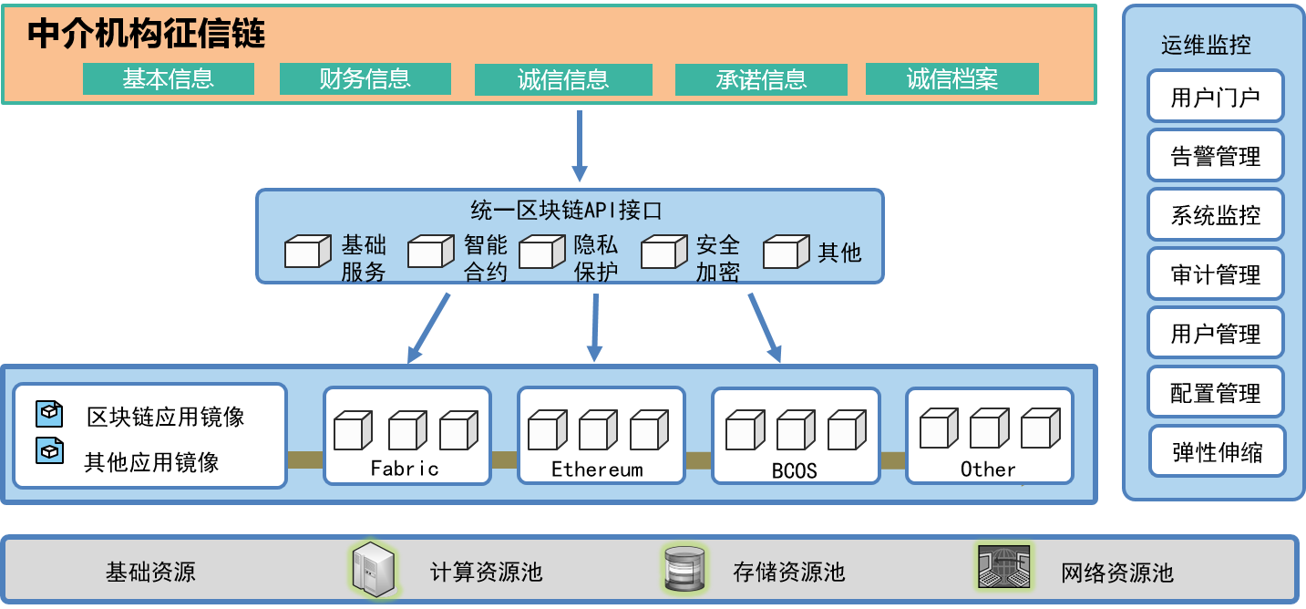
新型数据资源共享机制
基于深证金融区块链云平台搭建“中介机构征信链”

Slide 46
智能制造+区块链=？
Intelligent manufacturing+ Blockchain= ？

Slide 47
传统工业互联网 VS 分布式智能生产网络
效率更高
响应更快
能耗更低
基础设施和维护费用极高
一个故障导致全网崩溃
“工业云”为载体
“云链混合”生产网络
不同生产单元间通信困难

Slide 48
Traditional industrial Internet VS
distributed intelligent production network
效率更高
响应更快
能耗更低
Extremely high costs of infrastructure and maintenance
Higher efficiency
“Mix of Cloud and Blockchain”production network
One breakdown leads to collapse of the whole network
“Industiral Cloud”as a carrier
Faster Response
Communication difficulties between different production units
Lower energy
consumption

Slide 49


分布式智能生产网络 –以DIPNET为例
市场4.0：创造新需求
拉动
工业4.0：大规模定制化生产
碎片化
短生命周期
价格敏感度较低
多品种小批量
缩短产品上市时间
成本相较规模化生产略高
销售分成
支撑
影视制作公司
采购
获取免费道具
完成影视制作
智能合约范式
下单物料及生产指示
标准数字化工厂
工厂1
工厂2
……
工厂N
提供片源
提供道具库
观看产生需求
影视播放平台
销售分成
DIPNET分布式
智能生产网络
提供商品数字化
模型和实物Demo
需求导流
订单转移
完成购买
电商
平台
数据库对接
提供道具同款商品
各类数字化工厂解决方案商
如西门子
SAP
…
数据化工厂制造
执行系统建设
数据无缝对接
销售分成
区块链+新文创+智能制造=边看边买

Slide 50
Distributed intelligent production network —— DIPNET
Market 4.0：Creating new demand
Industry 4.0：Mass customization production
Drive
Fragmentation
Short life cycle
Low price-sensitivity
Multi varieties and small amount
Shortening product launch period
Cost is slightly higher than scale production.
Sales Division
Support
Film production company
Get free props
Complete film and television production
Purchase
Smart contract paradigm
Order material and production instructions
Standard digitalized factories
Factory 1
Factory 2
……
Factory N
Supply a source
Provide prop library
Watching produces demand
Video platform
DIPNET——Distributed intelligent production network
Sales Division
Provide digitalized models and objects of goods
Demand diversion
Order transfer
complete purchase
Ecommerce platform
Database connection
Provide props with the same commodity
Data factory manufacturing
Execution system construction
Various digital plant solutions providers
Like SIEMENS
SAP
…
Seamless data connection
Sales
Division
Blockchain + New cultural innovation + Intelligent Manufacturing = watch and buy

Slide 51
DIPNET大规模定制化生产流程图
自由品牌
产品技术商
工艺技术服务
小批量订单
生产服务
资源整合服务
第三方品牌
面料商
制造升级服务
DIPNET分布式
智能生产网络
技术及生产
委托服务
独立设计师
辅料商
质量保障服务
加工厂
大数据业务
支撑
个人顾客
仓储/物流
服务商
供应链金融
服务
团体顾客
自由销售渠道
第三方销售渠道

Slide 52
DIPNET: Large-scale customized production flow chart
Free brand
Product technology provider
Technical service
Small batch order production service
Resource integration service
Third-party brand
DIPNET——Distributed intelligent production network
Fabric supplier
Manufacture upgrading service
Technology and production commission
Independent designer
Excipient supplier
Quality guarantees
Processing factory
Big data service support
Individual customer
Warehousing / logistics service providers
Supply chain financial services
Group customer
Free sales channel
Third-party sales channel

Slide 53
产业区块链助力制造业转型升级
区块链
区块链定义未来
新零售：大文娱+智能制造
新制造：工业云+工业区块链
服务
服务定义组织
任何可以提供服务的人都是
你未来组织的一员
接口
接口定义平台
信息化、自动化、物联网、互联网、
对内对外都是接口标准化
软件
软件定义工厂
你的工厂就是由软件连接的数据生产车间
数据
数据定义产品
产品、部件、设计、面料、工序、工艺…
一切都是数据定义

Slide 54
Industrial blockchain promotes transformation and
upgrading of manufacturing industry
Blockchain
Blockchain defines the future
New retail: Entertainment + intelligent manufacturing
New manufacturing: Industrial cloud + industrial blockchain
Service
Service defines the organization
Anyone that provides service could be a member of an organization in the future
Interface
Interface defines the platform
Informatization, automation, Internet of things, Internet、Internal and external interfaces are standardized.
Software
Software defines the factory
Your factory is a data production workshop connected by software.
Data
Data defines the product
Products, components, designs, fabrics, processes and craftworks...
Everything is defined by data.

Slide 55
物联网+区块链=？

Slide 56


传统物联网 VS 区块链+物联网
降低物联网的运营成本
传统物联网：中心化服务器面临的负载随设备接入而增多，企业需投入大量资金来维持物联网体系的正常运转。
区块链技术+物联网：通过多个节点参与验证，将全网达成的交易记录在分布式账本中，取代了中央服务器的作用，解决物联网的规模化问题。
解决安全隐患、保护用户隐私
传统物联网：设备极易遭受攻击，数据易受损失且维护费用高昂。
区块链技术+物联网：全网节点验证的共识机制、不对称加密技术及数据分布式存储将大幅降低黑客攻击的风险。

Slide 57

分布式物联网安全解决方案-分布式智能配电信息安全系统（DIPS）
ZEBRA Node
Manager
Security
消息A
分布式
网络技术
加密技术
消息A加密
重构管理端与PDU的通讯通道
目标ZPDU
ZEBRA Node
窃听
拦截
篡改
消息A
消息A解密
分布式智能配电信息安全系统（DIPS）示例
分布式智能配电信息安全系统（DIPS）技术实现

Slide 58


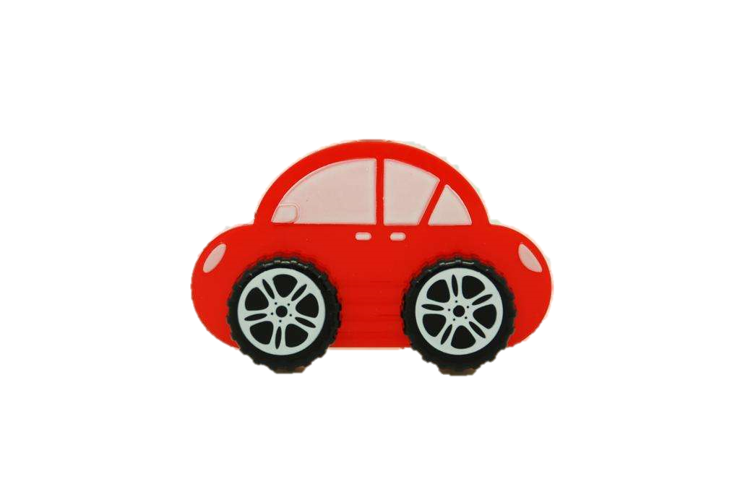
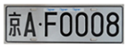


区块链+车联网：以SIGMA团队研发的智能交通项目为例
射频信号
读卡器
交通部门通过
区块链进行
相应的管理及查询
查询账户明细
电子车牌
接入区块链网络
验证车主身份
查询违章信息
读卡器主机
SIGMA
区块链
交换机
用SIGMA币充值
电子车牌端仅记录最终余额
机动车驶入
射频信号区域
电子车牌获得感应电流，车牌激活
读卡器获得
车牌信息
验证车主身份
查询其他信息
写入区块链网络生成区块并传播
进行扣款操作
接入区块链网络
验证身份
SIGMA
作为结算代币

Slide 59
公益+区块链=？

Slide 60
人人都相信公益：区块链+公益
区块链技术特点
传统公益存在的问题
受惠人群分布、资金到账时间、资金使用范围等方面的不透明易造成公众的不信任
公开透明
解决
效果有限，资金往往难以较为准确及时地到达最需要的受众手中
可追溯
信息披露成本高，导致公益机构提升透明度的难度加大
不可篡改

Slide 61
区块链+扶贫——以贵阳扶贫区块链为例——善款精准帮扶
SMART CONTRACT
捐助方
扶贫官员
智能合约
精准匹配项目
信息录入
指纹录入
扶贫项目
善款
善款全程追踪
信息录入
指纹录入
捐助方
贵阳市政府基于大数据精准帮扶平台上建立扶贫区块链应用
受赠方

Slide 62


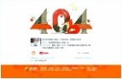




腾讯：公益寻人平台+区块链
传统公益寻人平台
区块链共享后的公益寻人平台
公益寻人平台
各自独立
寻人信息共享
状态实时共享
多中心存储

Slide 63

蚂蚁金服：支付宝爱心捐赠平台+区块链
“让听障儿童重获新声”
项目第一次试水成功
支付宝上所有爱心捐赠项目
接入到蚂蚁区块链平台
2016.7
2016.12
2017.3
2018.1
37家公益机构
超过300个公益项目
捐赠人次超过937万
捐赠总金额超过4800万元
“和再障说分手”
“照亮星星的孩子”

Slide 64

蚂蚁金服：支付宝爱心捐赠平台+区块链
支付宝
平台
无缝衔接
可溯闭环
爱心善款
记录上链
拨放去向
公益机构账户
受助人
账户
透明追溯
记录不可篡改
节省信息披露成本

Slide 65




Amply：南非贫困助童+区块链
跟踪资金使用情况
拥有控制
发放通证
数字身份
数字账户
进入特定中心
索取法币
转移通证

Slide 66
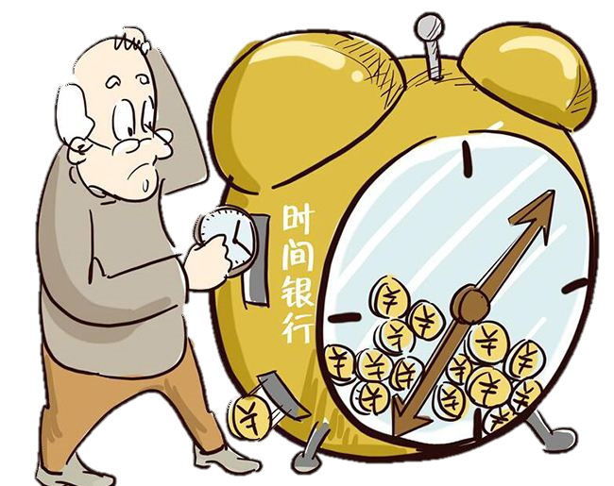
时间银行：公益养老+区块链
传统时间银行
存在地域性限制
将全球分散机构作为超级节点统一入驻DAPP，随时随地发布需求和提供服务
传统时间银行
数据易丢失或人为遗漏
全球各节点之间的公益服务记录在链上，分布式存储永不丢失
传统时间银行记录耗费大量人力
运用去中心化的区块链分布式记账功能记录

Slide 67

区块链服务实体经济的基本逻辑
The basic logic of blockchain service entity economy
产业协作环节信息化 Informatization of industrial cooperation
电子信息可信化 Electronic information credibility
数据资源资产化 Data resource assetization
“信任传递”的数据资源共享机制 Data transfer mechanism of "trust pass"
平台机构自证清白 Platform organization self-certification
政府实现穿透式监管 Government achieves penetrating supervision
多主体平等协作联盟组织 Multi-agent equal collaboration alliance

Slide 68
认识区块链
产业协作环节信息化
电子信息可信化
数据资源资产化
“信任传递”的数据资源共享机制
平台机构自证清白
政府实现穿透式监管
多主体平等协作联盟组织
Token/通证
一切权益的数字化
资金流和信息流融合
以钱包地址为基础的金融体系
一级和二级证券市场融合
新型平台经济
真·共享经济
社群组织经济化
分布式、不可逆的
数据库技术
新型独立数字
资产的载体

Slide 69
Understanding blockchain
Informatization of industrial cooperation
Electronic information credibility
Data resource assetization
Data sharing mechanism of "trust pass”
Platform organization self-certification
Government achieves penetrating supervision
Multi-agent equal collaboration alliance
Token
digitalization of rights and interests
Capital flow and information integration
Financial system based on wallet address
Primary and secondary market integration
New platform economy
True sharing economy
Economization of community organizations
Distributed, irreversible
Database Technology
New independent
number
Carrier of assets

Slide 70
区块链技术落地的主要影响
The main impact of blockchain technology landing
01
02
03
04
降低实体经济成本
Reduce the cost of the real economy
提升产业链协同效率
Improve the synergy efficiency of the industry chain
优化产业诚信发展环境
Optimize the environment for industrial integrity development
引导资金脱虚入实
Guide funds out of the way
不要神化，不要妖魔化 Don't deify, don't demonize
信息上云，交易上链 Information on the cloud, transaction on the chain
区块链未来三年将在实体经济中广泛落地
The blockchain will be widely used in the real economy in the next three years.

Slide 71
区块链发展六大趋势
区块链成为全球技术发展的前沿阵地，开辟国际竞争新赛道
A
区块链领域成为创新创业的新热土，技术融合将拓展应用新空间
B
D
区块链打造新型平台经济，开启共享经济新时代
区块链未来三年将在实体经济中广泛落地，成为数字中国建设的重要支撑
C
E
区块链加速“可信数字化”进程，带动金融“脱虚向实”服务实体经济
F
区块链监管和标准体系将进一步完善，产业发展基础继续夯实

Slide 72
Six major trends in blockchain development
Blockchain has become the forefront of global technology development, opening up new international competition tracks
A
The blockchain field has become a new hot spot for innovation and entrepreneurship, and technology convergence will expand the application of new space.
Blockchain creates a new platform economy and opens a new era of sharing economy
B
D
C
E
Blockchain accelerates the process of “trusted digitization” and drives financial “de-virtualization” to serve the real economy
The blockchain will be widely used in the real economy in the next three years and become an important support for the construction of digital China.
F
The blockchain supervision and standards system will be further improved, and the foundation of industrial development will continue to be solidified.

Slide 73
区块链赋能实体经济：站在未来看现在
“区块链+”绝不仅仅是一次技术升级，而是社会组织方式、协作方式、分配方式的全方位变革
重构信任基础
重构商业模式
01
02
从品牌信任到技术信任
从信息共享到价值共享
区块链思维
区块链+的创新模式是爆发式创新、突变式创新
重构协作体系
重构权益形态
03
04
从企业组织到社群组织
从会员积分到通证经济

Slide 74
Blockchains empower economy：the prospect
“”Blockchain +” is not just a technological upgrade, it's an all-around change in the way of social organization,
collaboration and distribution.
Reconstruct foundation of trust
Reconstruct business models
01
02
From ” Trust Brand” to “Trust Tech”
From ” Information Sharing” to “ Value Sharing”
“Blockchain Thinking”
The innovation of “ blockchain +” is explosive and radical.
Reconstruct collaboration system
Reconstruct form of rights and interests
03
04
From “enterprise” to “community”
From “Member Points” to “Token Economy”

Slide 75
区块链赋能实体经济：区块链+战略变革的火箭模型
「区块链+」引发产业变革的速度和广度将会是「互联网+」的十倍
战略为先
文化为核
”区块链+“是一种社会级、产业级的深层次变革。在全新的产业组织体系中，市场形态、运营模式、财务管理、技术架构发生了翻天覆地的变化，因此，必须从企业的顶层战略变革出发，引发全面变革，方有机会成为时代的弄潮儿。
要想在”区块链+“时代取得大发展、大进步，最关键的支撑是发展理念，因此必须有相应地企业文化相匹配，包括开放共享、协同创新等新理念，以吸引到真正志同道合的伙伴和人才，共成大业。
技术为翼
组织为本
区块链本质上还是一项技术创新，“区块链+”变革也是由技术创新驱动，技术创新能力和技术储备将对未来竞争格局产生至关重要重要影响，技术储备的本质是创新人才的储备。
通过权益形态的变革，打破企业边界，让用户等所有利益相关人深度参与到经营活动中，实现企业向社群化组织形态的转变，从根本上自我革新，才有机会实现降维打击，获得前所未有的竞争优势。

Slide 76
Blockchains empower economy：the Rocket Model of “blockchain+” strategic change
The speed and breadth that ”Blockchain +” triggers industrial change will be ten times “Internet +”.
Strategy First
Culture as the Core
"Blockchain +" is a deep social and industrial revolution. In the brand-new industrial organization system, the market form, operation mode, financial management and technical structure have undergone tremendous changes. Therefore, we must start from the top strategical changes of enterprises, trigger a comprehensive change, and then have the opportunity to become the era of beach-goers.
In order to achieve great progress in the "blockchain +" era, the most critical support is the concept of development. Thus, there must be corresponding corporate culture matching including open and sharing, collaborative innovation and other new concepts to attract genuine like-minded partners and talent to achieve magnificent things.
Tech as the Wing
Organization as the Basis
The blockchain is essentially a technological innovation, and the "blockchain +" transformation is also driven by technological innovation. The ability of technological innovation and technological reserve will have a crucial impact on the future competition pattern. The essence of technological reserve is the reserve of innovative talent.
Through the reform of the rights and interests form, enterprises are able to break the boundary, let stakeholders deeply participate in business activities, realize the transformation of the enterprise to the community form and fundamentally revolute themselves. Only then can they have the opportunity of dimensionality reduction attack and gaining unprecedented competitive advantage.

Slide 77
『区块链+』时代，唯『穿越者』才能生存
以终为始，方得始终
踏上穿梭到未来的时光机
穿越历史的迷雾
站到未来看现在
——成为人类历史大跃迁大变革的观察者、见证者、参与者、推动者！
暴风雨即将来临，谁会是那只海燕？
——在区块链+的世界里
没有50、60、70、80、90后
只有进击与退守

Slide 78
The era of『Blockchain+』，only『Traverser』can survive
Always begin with the end.
Stepping into the future time machine,
Passing through the mist of history,
Standing in the future and look at the present.
——to become observers, witnesses, participants and promoters of great changes in human history！
Who will be the petrel when the storm is coming?
There is no age difference
In the world of “blockchain +”
There is only attack and retreat.

Slide 79


全球区块链领导者课程
Global Blockchain Leaders Programme
火币大学 Huobi University
Huobi University is a global educational institute to empower digital economy with Blockchain.

Slide 80
全球区块链领导者课程（模块制）
Global Blockchain Leaders Programme (Modular)
旨在为区块链及关注其应用前景的的技术领导者、商业领导者追踪区块链技术、应用与投资前沿，把握区块链的战略机遇。
本课程专为领先企业与项目的创始人、CEO等企业最高决策者开设，课程形式为模块制，包括课程、私董会、访学等多模块形式。
由火币大学校长、原工信部信息中心工业经济研究所所长于佳宁博士亲任课程主任。
开课日期
2018年11月-2019年4月
课程：趋势模块
区块链产业趋势
技术前沿、政策趋势
数字经济前景
开课语言
中英文双语授课配翻译
开课地点
北京、海南、硅谷等
课程：产业模块
区块链+产业场景逻辑
通证经济模型设计
战略转型与变革
开学典礼暨学术报告会
区块链全球政策
区块链学术研究
区块链技术前沿
课程费用
128,000 RMB *
课程：投资模块
区块链与新经济新金融
区块链产业投资趋势
区块链+金融专题
硅谷区块链+高峰论坛
区块链业界、投资人、
思想者共同探讨前景
学员毕业报告会
私董会+访学
区块链家特别I私董会(6个月)
区块链技术企业及实体企业
访学研讨
* 课程费用包括学费、案例使用费、午餐费、资料费、文具费、其他相关材料费、住宿费。不含国际模块的机票与酒店费用。
** 保留对课程信息(包括价格、优惠条件、日期、地点、师资、课程安排等其他细节)进行调整的权利。

Slide 81
Global Blockchain Leaders Programme (Modular)
Global Blockchain Leaders Programme (GBLP) aims to help tech leaders and business leaders to master blockchain technology, its applications and investment. This programme is offered for leaders in leading companies and blockchain initiatives. This is a modular programme include lectures, private advisory board and field study. Dr. Jianing Yu, President of Huobi University, former director of Industrial Economics Research Institute of Information Center of Ministry of Industry and Information Technology (MIIT) is the course director.
Time
2018.11 ~ 2019.14
Module 1
Trends of Blockchain
Blockchain Industry Trends
Technology Outlook and Policy Trends
Digital Economy Outlook
Language
Bilingual teaching and translation
(English & Chinese)
Location
Beijing, Hainan and Silicon Valley
Module 2
Blockchain and Industry
Blockchain+ Industrial Scenario Logic
Token Economy Model
Strategic Change and Transformation
Opening Ceremony &
Industry Leader Report
Blockchain Policy
Blockchain Research
Blockchain Technology Frontier
Course Fee
128,000 RMB *
Module 3
Blockchain and New Economy
Blockchain Industry Investment Trends
Blockchain+ Finance Project
Silicon Valley Blockchain+ Forum
Cross-Border Discussion
Student Graduation Forum
Private Advisory Board
& Field Study
6 Months
Special Private Advisory Board
Enterprise Field Study
* The course fee includes tuition, case usage, lunch, files, stationary, accommodation and other material fees. International flight tickets and overseas hotel fees are not included.
** Huobi University reserve the right to adjust the course information (including price, preferential terms, date, place, teachers, course arrangement and other details).

Slide 82
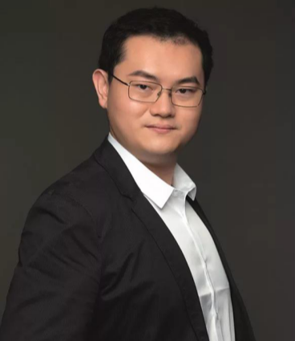

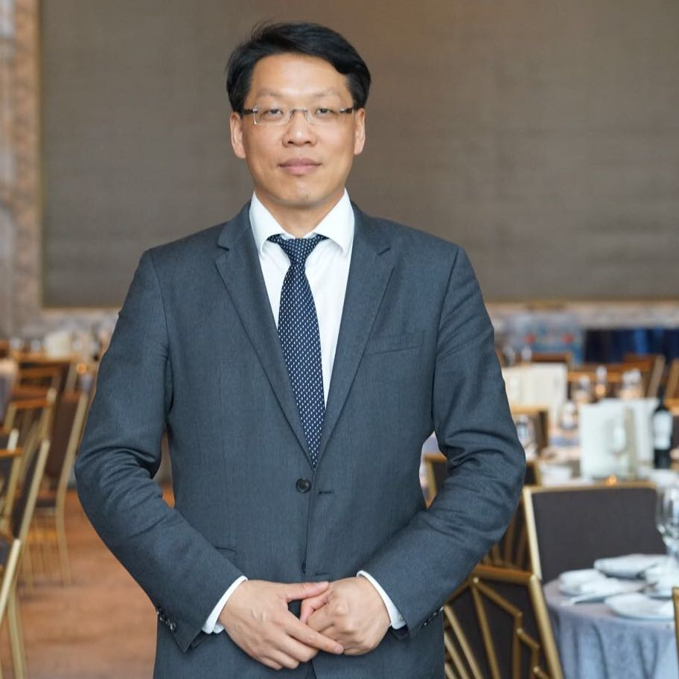
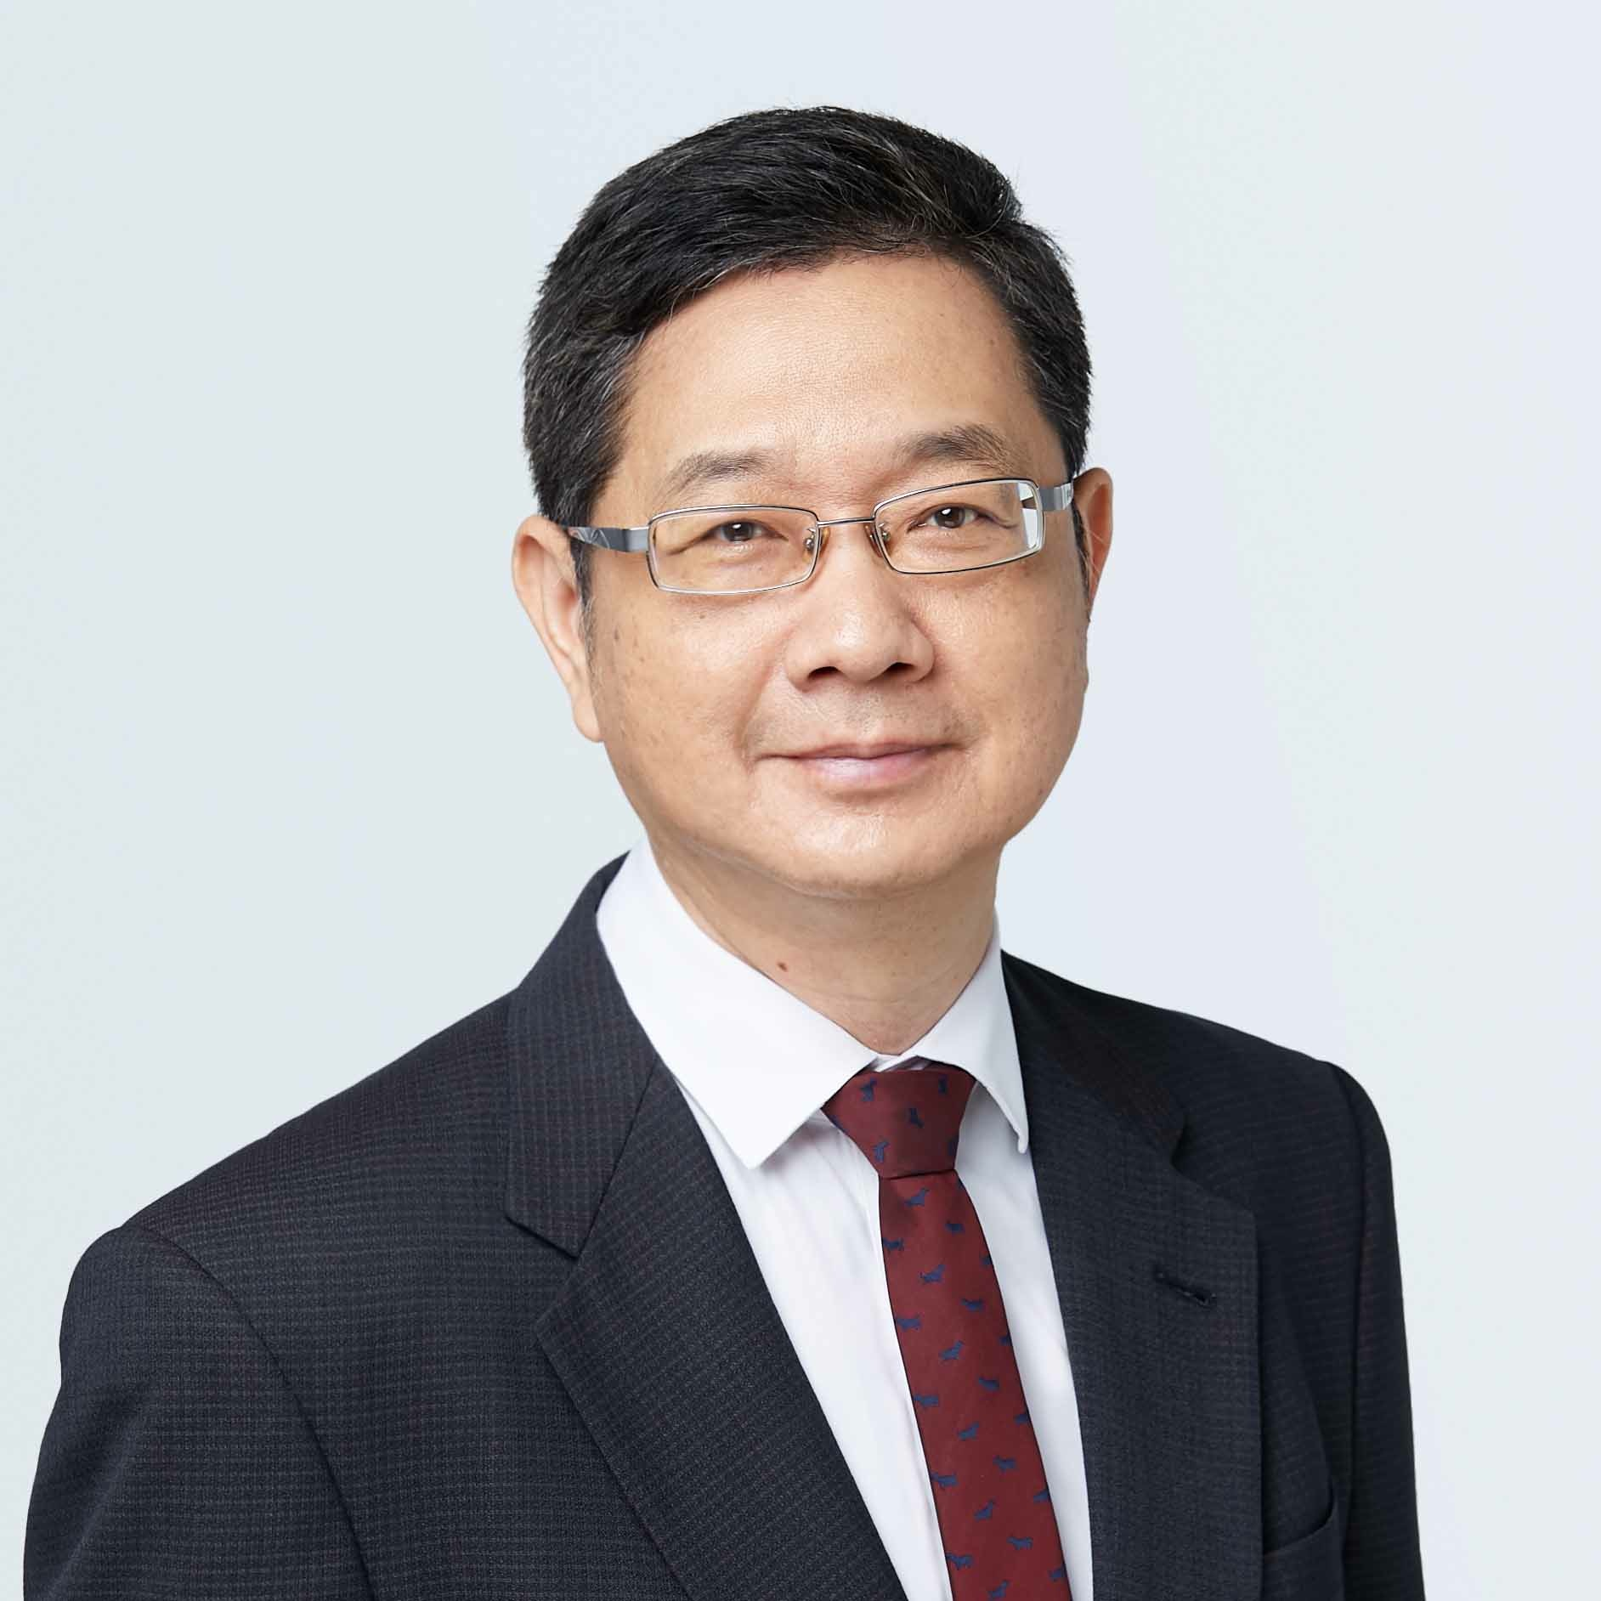
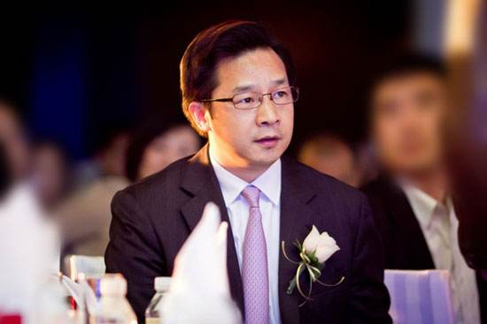
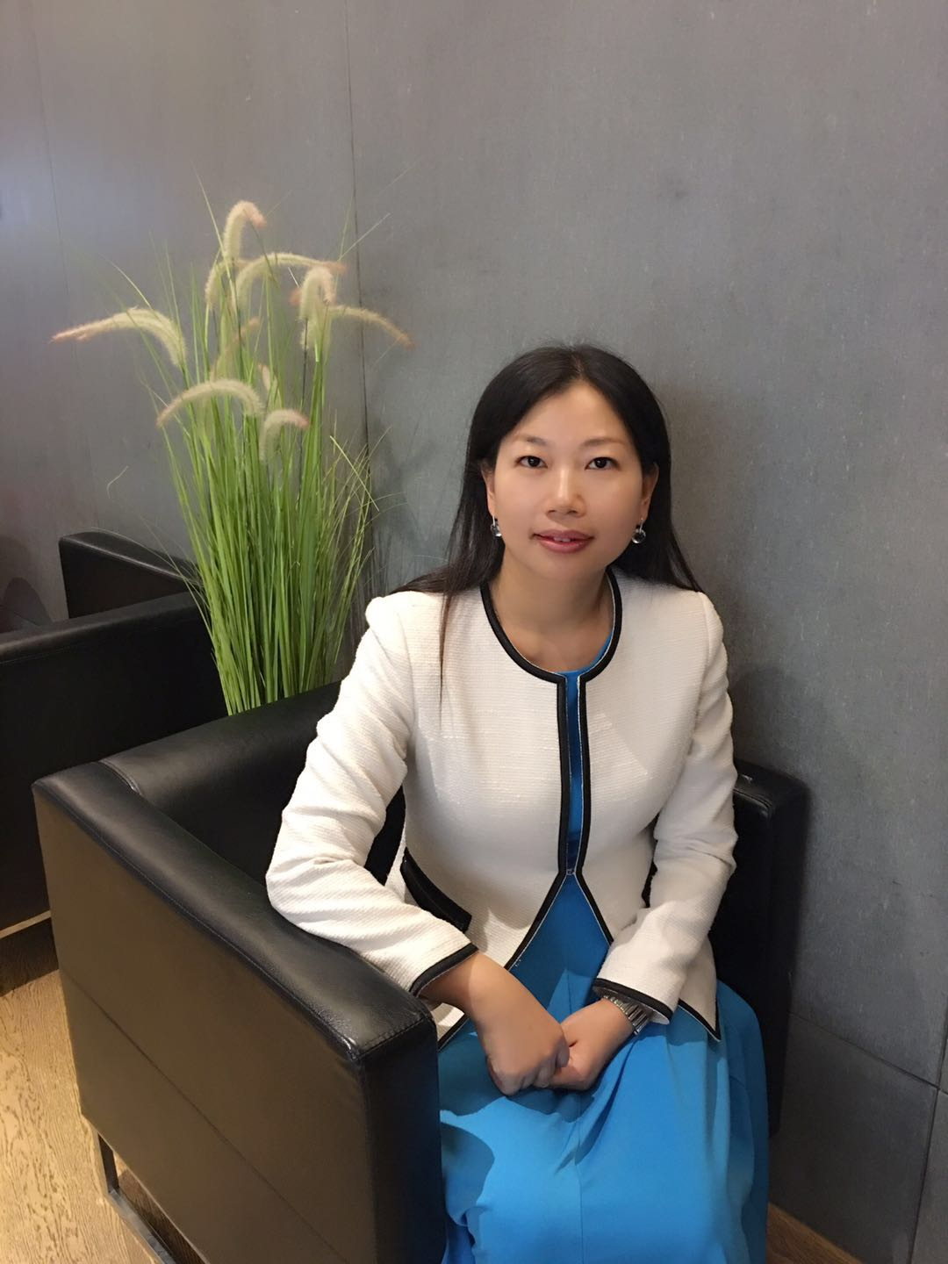
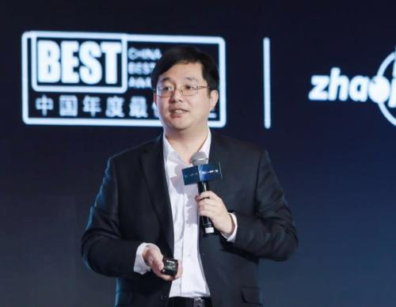
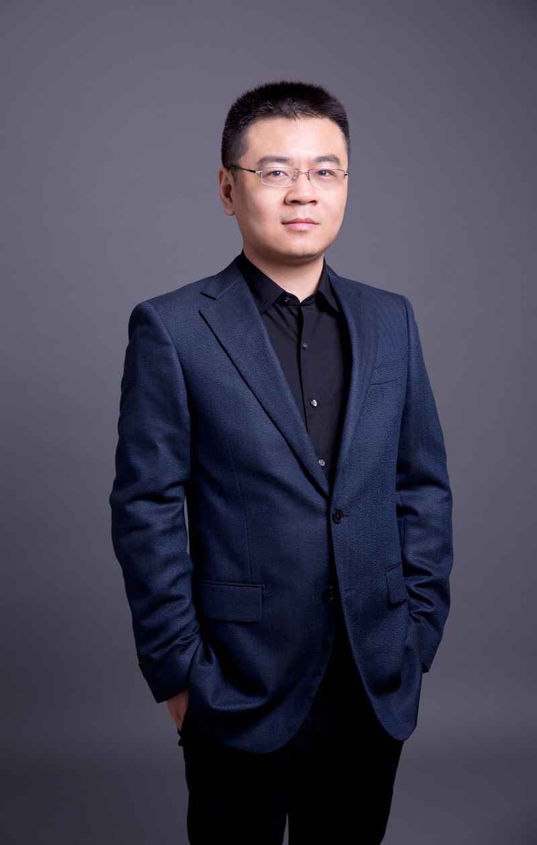
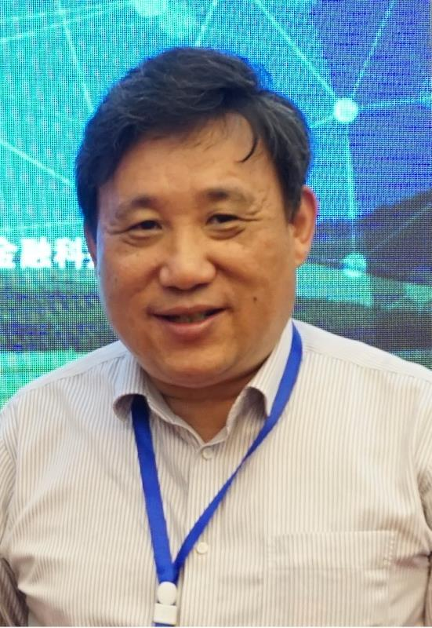
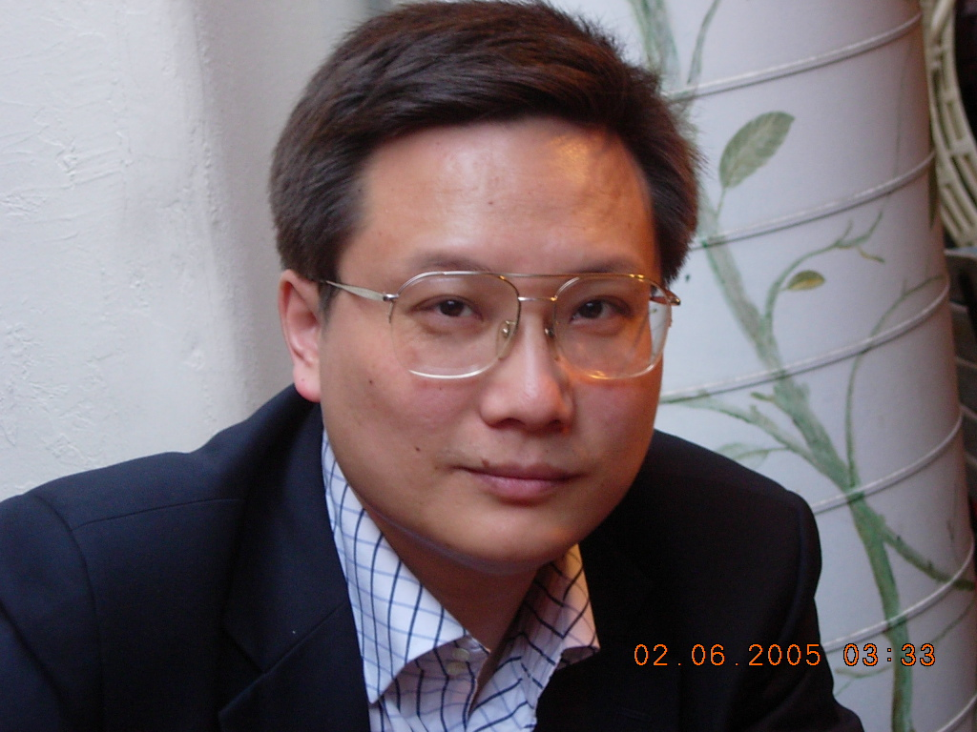
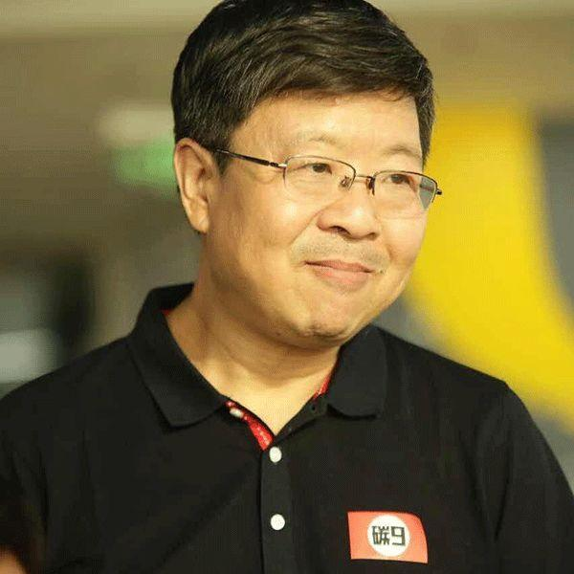
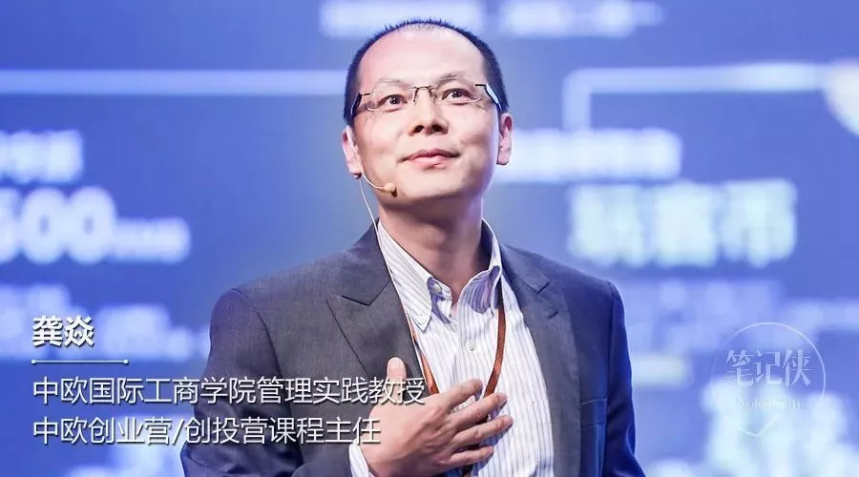
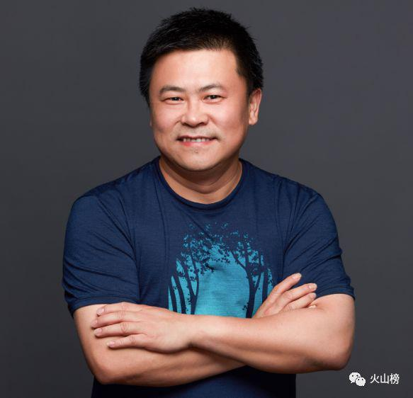


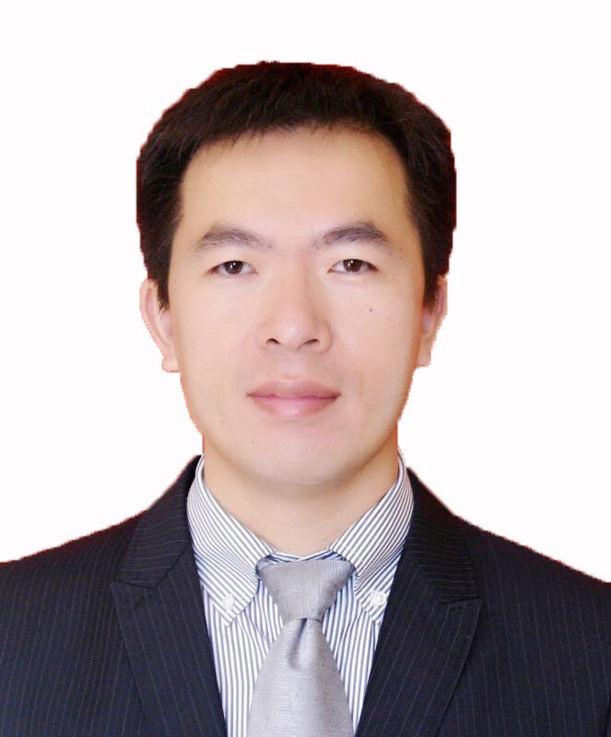
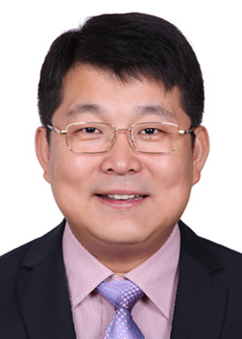
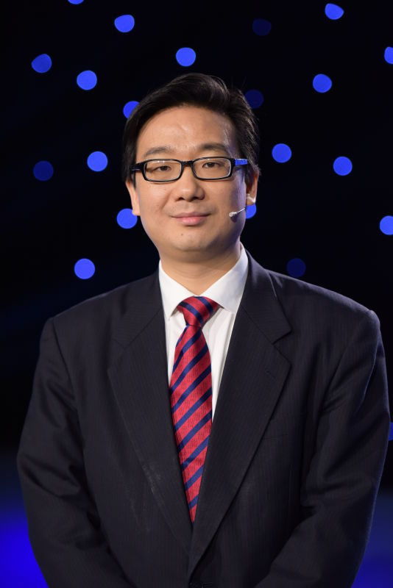
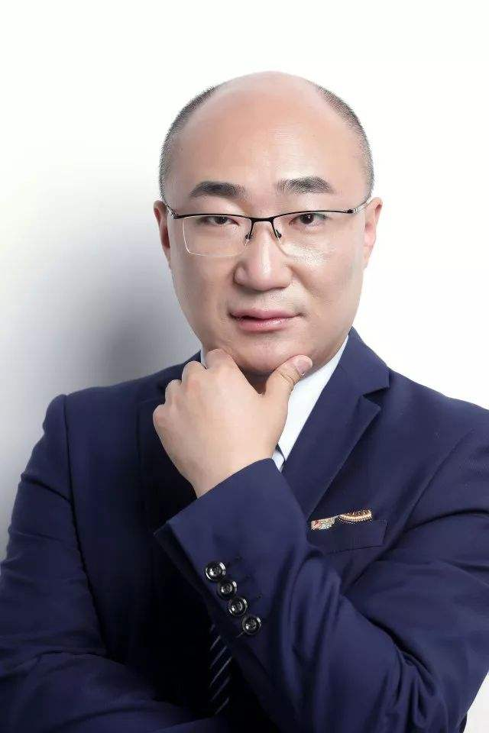
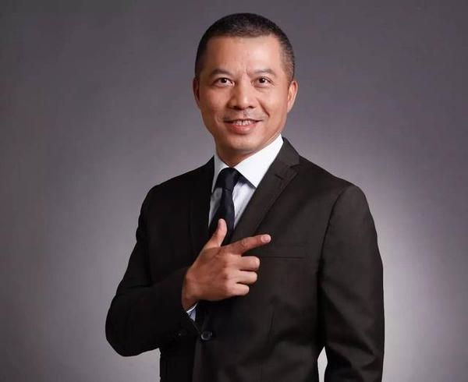
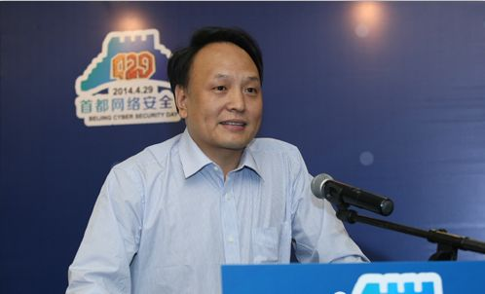


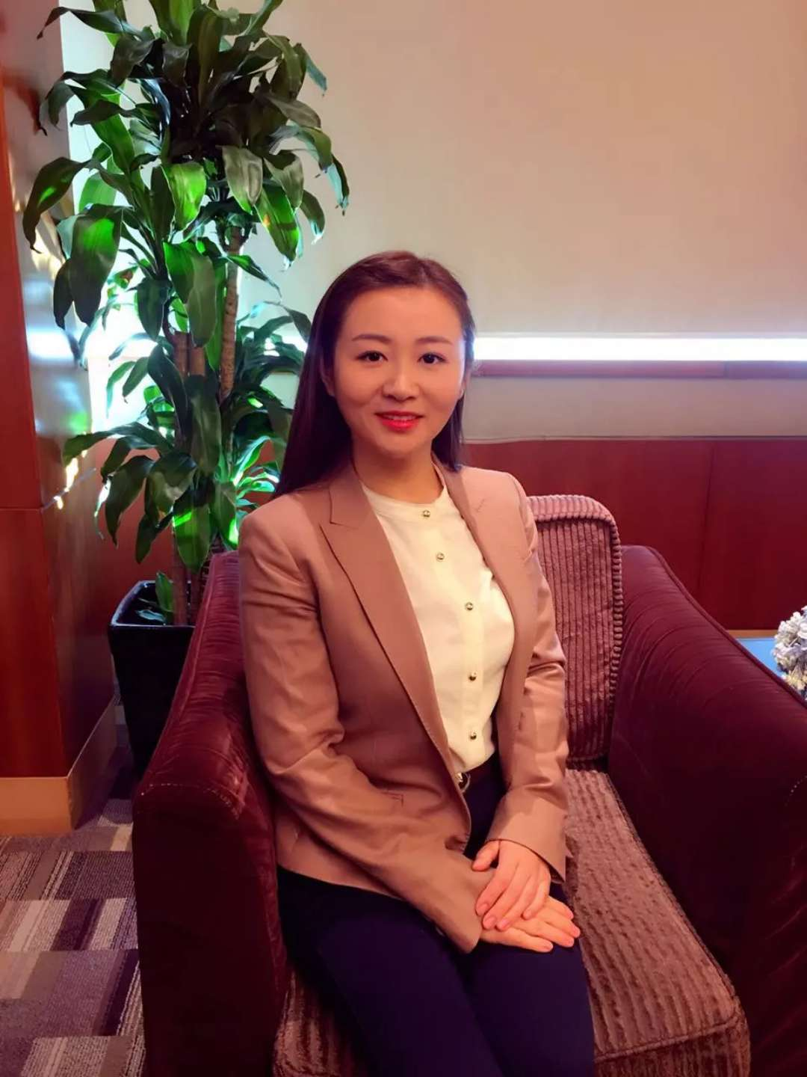
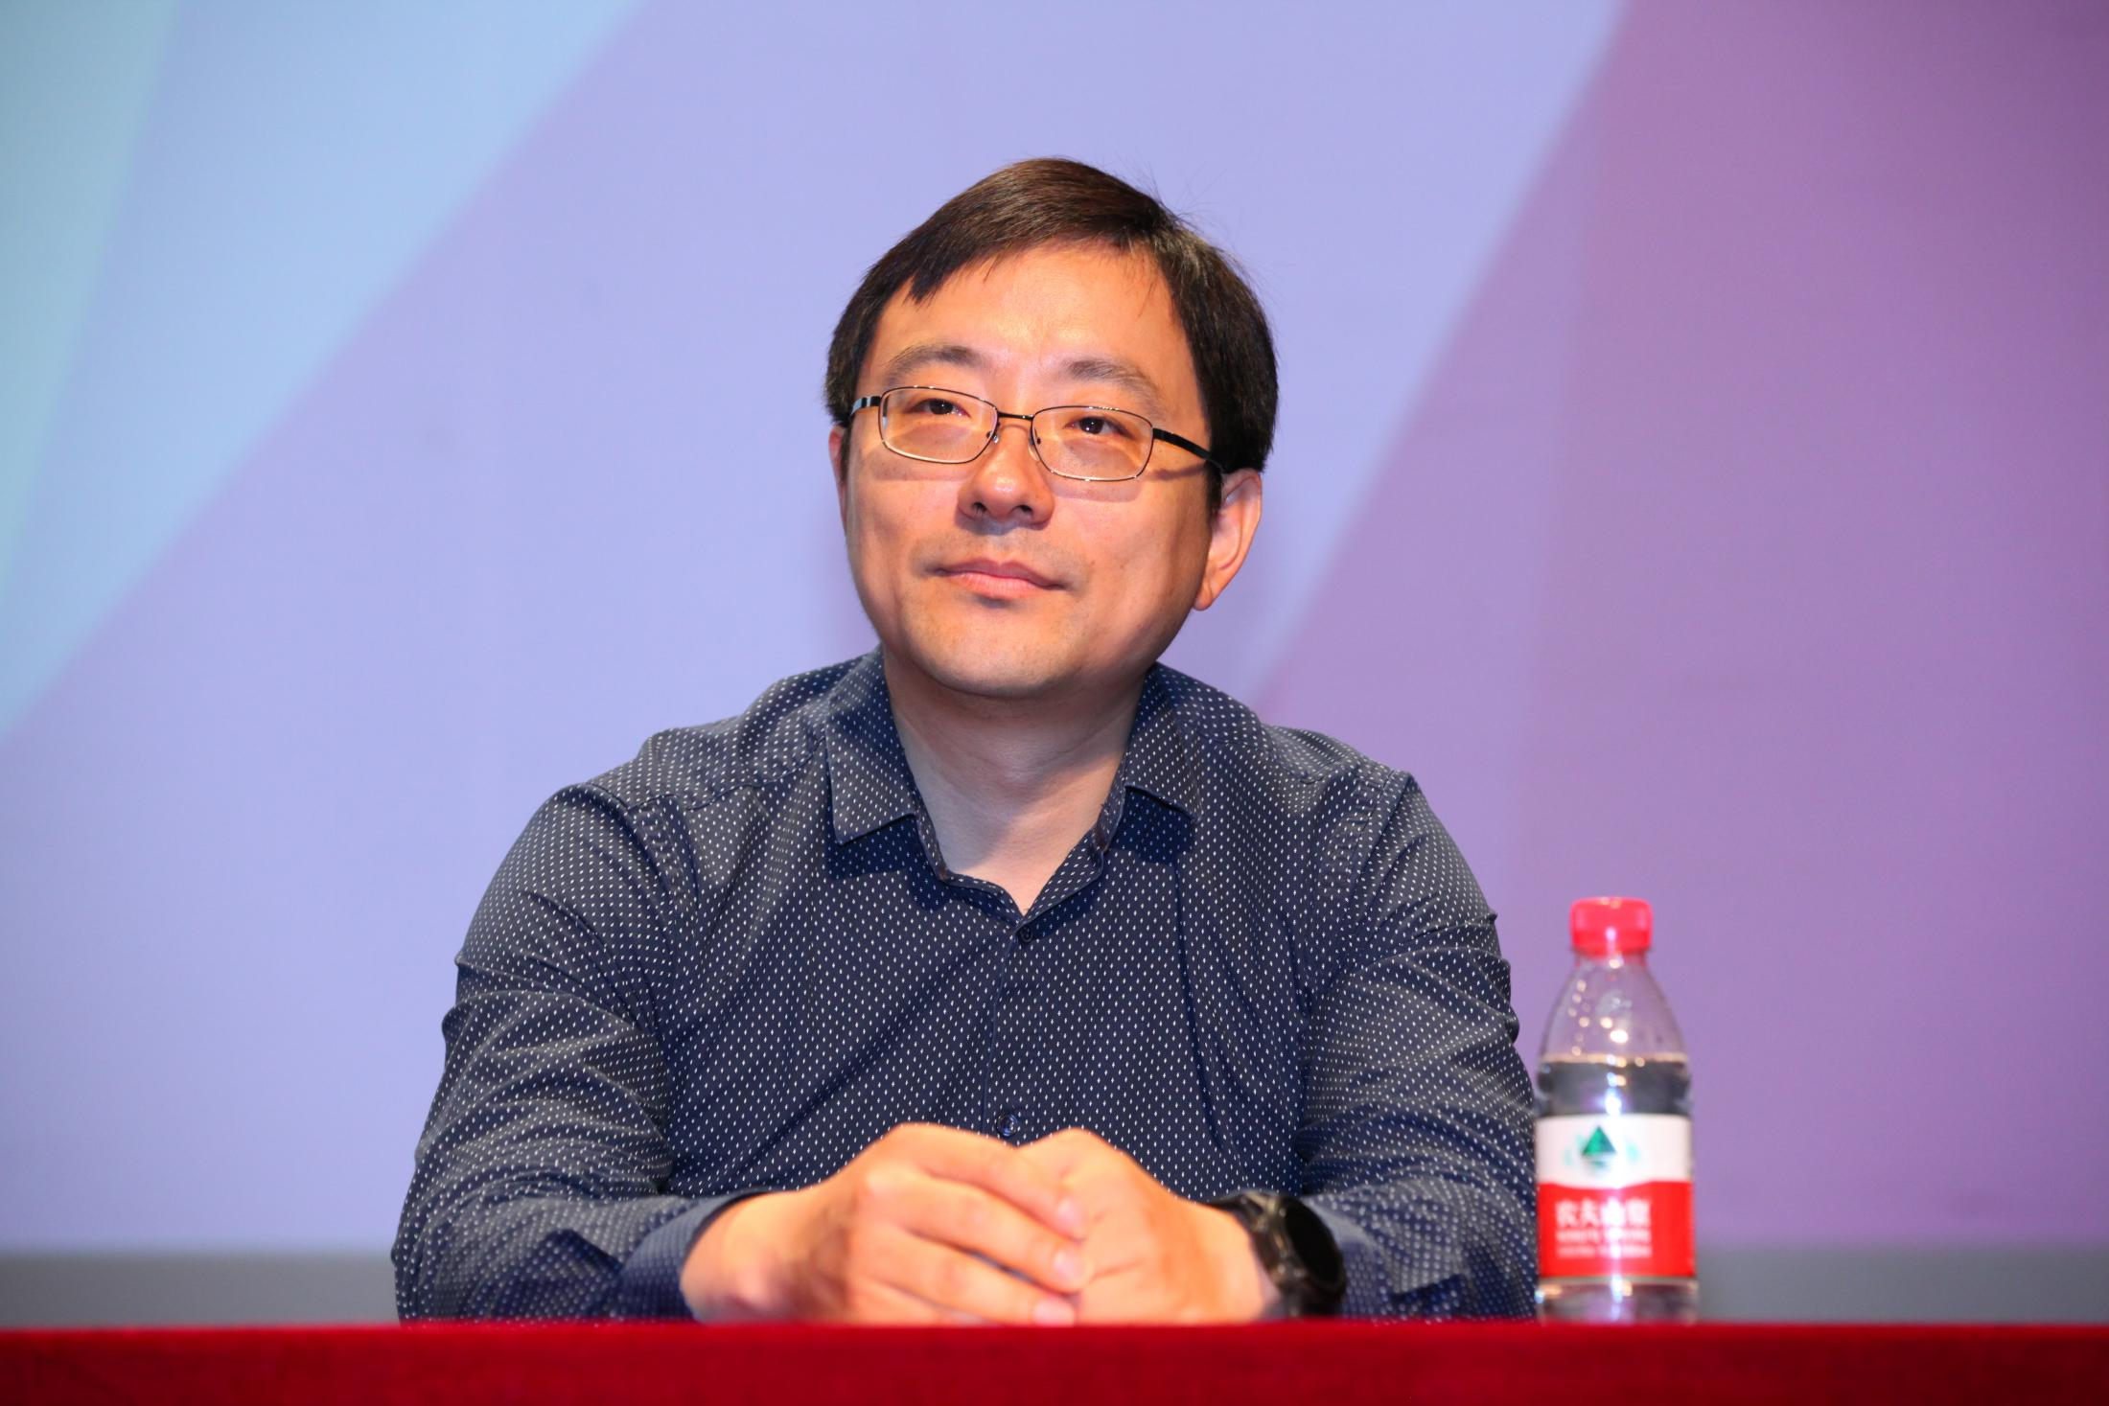
亮点：「区块链顶级导师」
由全球区 块链思想者、区块链技术专家、区块链行业领军人物组成
课程主任
课程学术指导
课程导师与业界嘉宾
于佳宁
火币大学校长
张首晟
斯坦福大学教授
中科院外籍院士
Don Tapscott
《区块链革命》作者
数字经济之父
蔡栋
蔡维德
曹辉宁
陈文君
陈永伟
方军
斯雪明
复旦大学教授
周子衡
社科院金融所副研究员
冯新
龚炎
郭强
霍力
李林
林华
刘赫
…
杨东
人民大学法学院副院长
孟岩
通证派学者
CSDN副总裁、柏链道捷CEO
刘小鹰
马兆丰
帅初
王峰
肖飒
徐恪
袁煜明

Slide 83
Highlights: "Top Blockchain Tutor"
Composed of global blockchain thinkers, blockchain technologists, and blockchain industrial leaders
Course Director
Academic Guidance
Course Instructor and Industry Guests
Yu Jianing
President of
Huobi University
Shousheng Zhang
Professor of Stanford University
Foreign academician of the Chinese Academy of Sciences
Don Tapscott
Author of Blockchain Revolution
Father of the digital economy
Dong Cai
WeiDe Cai
Huining Cao
Wenjun Chen
Yongwei Chen
Jun Fang
Xueming Si
Professor of
Fudan university
Ziheng Zhou
Associate Research Fellow, Institute of Finance,
Chinese Academy of Social Sciences
Xin Feng
Yan Gong
Qiang Guo
li Huo
Lin Li
Hua Lin
He Liu
Sha Xiao
Ge Xu
Hubery Yuan
Dong Yang
Vice Dean of Law School
of Renmin University of China
Yan Meng
Vice Chairman of Blockchain
Expert Committee, CCIA
Vice President of CSDN, CEO of PDJ Education
Xiaoying Liu
Zhaofeng Ma
Patrick Dai
Feng Wang
…

Slide 84
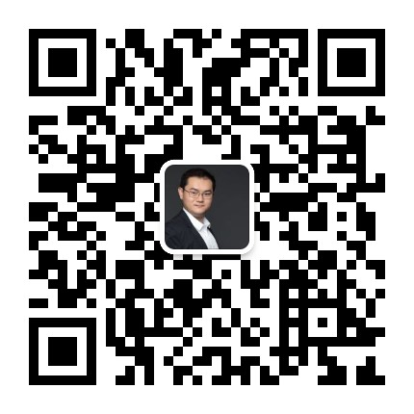
于佳宁 博士
火币大学校长
原工信部信息中心工业经济研究所所长
中国通信工业协会区块链专委会副主任委员
中国国际经济技术合作促进会区块链技术与应用工委副秘书长
中国信息通信研究院互联网新技术新业务安全评估中心高级评估专家
中国电子商会区块链专委会高级顾问
中国计算机学会区块链专委会委员
中国移动通信联合会国际区块链联盟专家委员会副主任委员
中国服务贸易协会区块链委员会专家顾问
中国云体系产业创新战略联盟链网创新中心副主任
《2018年中国区块链产业白皮书》编委会主任
《2018年中国泛娱乐产业白皮书》编委会主任

Slide 85
火币中国简介
火币中国
打造区块链+产业服务一站式平台
火币中国致力于引领区块链行业的产业升级，以区块链技术赋能各个行业领域，依托火币研究院、火币大学(中国)、火币、 Labs、火币英才和火币律林，打造区块链行业全生命周期专业服务，为政府和企业提供定制化解决方案，共同构建区块链应用新经济实体，提升行业效率并培养专业人士，以科技改变世界，用创新成就未来。
火币中国
培训服务
技术服务
孵化服务
人才服务
法律服务
咨询服务

Slide 86
Introduction of Huobi China
Huobi China
Provide “Blockchain + Industry”one-stop service.
Huobi China is committed to leading upgrades in blockchain industry and empowering various fields with blockchain. Relying on Huobi Blockchain Research, Huobi University, Huobi Labs, Huobi Talent and Huobi Law Forest, Huobi China provides full life-circle services in blockchain industry, including providing customized solutions for government and enterprises, buiding the new economy of blockchain application as well as promoting the efficiency of industry and cultivating professionals.
Huobi China
Training
service
Tech
service
Incubation
service
Talent
service
Law
service
Consulting
service

Slide 87

火币中国简介
火币律林
国内最早提供区块链法律服务的团队，业务涵盖法律研究、项目合规风控、投资并购、诉讼仲裁等等
火币研究院
全面拓展区块链各领域的研究与探索，加速区块链技术开发，推动行业应用落地
火币英才
成为区块链行业人才领域的优质服务平台，业务涵盖招聘、管培、外语翻译等等
火币Labs（中国）
定位区块链产业生态“连接器”，打造全球一流分布式生态孵化实验室
火币大学（中国）
以区块链人才培养为核心，推动区块链等前沿科技落地应用，推动数字经济与实体经济深度融合

Slide 88
Introduction of Huobi China
Huobi Law Forest
is the earliest company that provides blockchain law service including law research, project compliance and risk control, investment and aquisition as well as litigation and arbitration.
Huobi Blockchain Research
expands the research and exploration in various fields of blockchain, accelerates the development of blockchain technology and promotes the application of blockchain in industries.
Huobi Talent
becomes a high-quality service platform in the talent field of blockchain industry, covering recruitment, management and training, translation and etc.
Huobi Labs（China）
positions as a blockchain industrial ecology "connector", creates the world's first-class distributed ecology incubation laboratory.
Huobi University（China）
with the core of personnel training for blockchain industry, is committed to promoting the application of cutting-edge blockchain technologies, and the deep integration of the digital economy and the real economy.

Slide 89




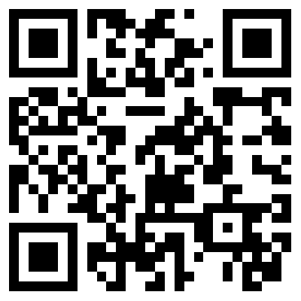



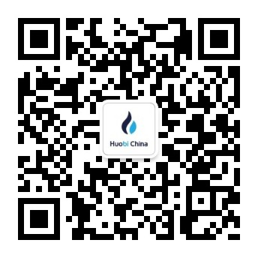




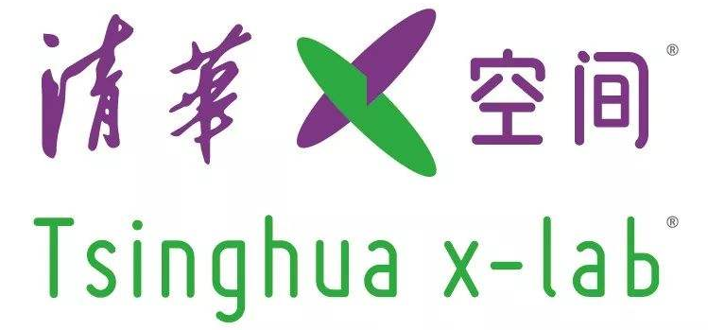
火币中国简介
官 网 地 址
https://www.huobi.cn/
业界
：
联 系 邮 箱
contact@huobi.cn
微信公众号
HuobiCN
学界
：
新 浪 微 博
HuobiChina

Slide 90
Introduction of Huobi China
Cases
Contact us
Website
https://www.huobi.cn/
业界
：
E-mail
contact@huobi.cn
Wechat
HuobiCN
学界
：
Sina Weibo
HuobiChina

Slide 91

大学简介
火币大学隶属于火币中国，是一家致力于推动区块链赋能实体经济的全球性教育机构。
大学下设“中国境内事业部与海外事业部”两大管理主体；“学术委员会与顾问委员会”两大智囊团；“全球区块链赋能中心、全球区块链发展研究中心、全球区块链人才培养中心”三大中心，并将在世界范围内设立若干分校、分中心等办学机构。
.

Slide 92
Introduction of Huobi University
Huobi University，belonging to Huobi China, is a global educational institution promoting blockchain empowerment of the real economy. Huobi University is established into two main management entities including“Domestic Business Unit and Overseas Business Unit” with two think tanks, i.e. Academic Committee and Consultative Committee, three centers, i.e. Global Blockchain Empowerment Center, Global Blockchain Development & Research Center, and Global Blockchain Personnel Training Center, as well as worldwide campuses and sub-centers.
.

Slide 93
大学简介
火币大学以区块链产业人才培养为核心，以“推动区块链等前沿科技落地应用，推动数字经济与实体经济深度融合”为己任，积极助力培育各区域、各产业经济发展新动能。
在实践探索方面，火币大学将立足城市发展，深耕产业研究，搭建区块链赋能实体产业的服务生态，让企业实实在在抓住区块链时代所带来的发展机遇。
1
人才培养
经济发展
新动能
2
企业赋能
3
资源对接
.

Slide 94
Introduction of Huobi University
Huobi University, with the core of personnel training for blockchain industry, is committed to “Promote the application of cutting-edge blockchain technologies, and the deep integration of the digital economy and the real economy” to actively assist in the education and economy development in various regions and industries.
In the aspect of practical exploration, Huobi University will deepen the industrial research and establish a service ecology for blockchain real industry empowerment based on the development of city, to bring the development opportunities to the enterprises in the blockchain era.
Personnel
Training
1
New Growth Drivers for Economic Development
2
Enterprise
Empowerment
3
Resource
Exchange
.

Slide 95

理念阐述
愿景
使命
成为区块链产业推动者
培养区块链产业人才
促进区块链技术加速创新
推动区块链赋能实体经济
价值观
正念
正解
正能量
经营宗旨
人才培养布局全球
产业赋能根植中国
.

Slide 96
University Concept
Vision
Mission
To become a promoter of blockchain industry empowerment
To conduct personnel training for blockchain industry
To promote the acceleration of blockchain technology innovation
To promote real economy of blockchain empowerment
Sense of Worth
To be with positive belief
To be with positive solution
To be with positive energy
Principles
Global personal training
Industrial Empowerment rooted in China
.

